Slide 1








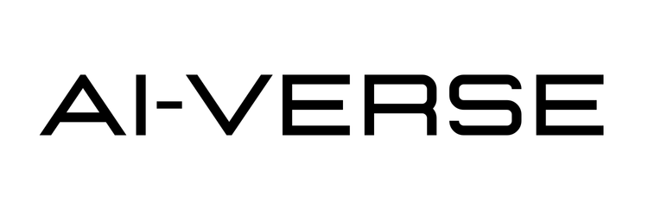
IETE Student Forum
Amrita Vishwa Vidyapeetham
Team Name : Tech Stars
Team Leader Name : K. Yogananda Reddy
Track : Agentic AI

Slide 2

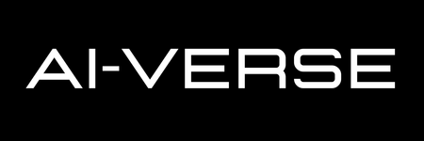
The Concept: CareerFlow.ai is an Autonomous Agentic AI System designed to act as a "Career Co-Pilot" for students. It moves beyond simple job searching to actively manage the entire career lifecycle—from identifying skill gaps to applying for jobs and learning from rejections.
Core Philosophy: "Don't just find a job; prepare for it." The system uses active reasoning to bridge the "Translation Gap" between a student's raw skills and market employability.

Slide 3
Opportunity
1. How different is it from existing ideas?
  Existing Portals (LinkedIn/Naukri): Static search engines. They only show jobs.
  Our Solution: It is Agentic. It doesn't just show a job; it reads your resume, plans a learning schedule to fit that job, and writes the cover letter for you.
2. How will it solve the problem?
  It solves the "Lack of Feedback" issue by conducting Interview Post-Mortems—analyzing why a user failed and updating their roadmap instantly.
  It reduces "Application Anxiety" by automating the drafting of high-quality, personalized emails.

Slide 4
Opportunity
3. USP (Unique Selling Proposition):
  The "Rejection Learning Loop": The only system that gets smarter every time you fail an interview.
  Real-Time Skill Arbitrage: Scans live market trends to find "low hanging fruit" jobs that match your current skills.

Slide 5
List of features offered by the solution
AI Profiler & Gap Analyzer: autonomously extracts resume details and calculates a "Match Score" against target roles.
Just-in-Time Learning Sprints: Generates dynamic 1-week learning schedules to fix critical skill gaps before an interview.
Autonomous Action Agent: Auto-drafts personalized cold emails and cover letters to recruiters.
Real-Time Market Scout: Analyzes live trends to surface Jobs, Internships, and Hackathons that match the user's skill level.
Active Feedback Loop: Users input failed interview questions, and the agent identifies the concept gap and suggests resources.
Mock Interview Simulator: A chat-based AI interviewer to practice technical questions.

Slide 6
Process flow diagram or use-case diagram
Profile Agent (skills, resume, goals)
Market & Trend Agent (jobs, skills, demand)
USER
Interview & Outcome Feedback
Action Agent (job alerts, learning tasks)
Planner Agent (roadmap & priorities)
Learning Agent (updates memory & plan)

Slide 7
AI Technologies to be used in the solution
Large Language Model (LLM): Google Gemini 1.5 Flash (for high-speed reasoning and content generation).
Natural Language Processing for resume and interview analysis
Similarity matching algorithms for job–skill matching
Rule-based planning for career roadmap generation
Feedback-based learning logic for adaptation over time
Lightweight data storage (JSON / database) for agent memory

Slide 8
Streamlit UI (Frontend)
Agentic Orchestration Engine (Python)
Foundation Layer
User Input (PDF Resume)
Interactive Dashboard (Tabs)
Feedback Interface (Chat)
Profiler Agent (Parser)
Market Scout Agent (RAG/Trends)
Planner Agent (Roadmap Generator)
Action Agent (Email Drafter)
Learning Agent (Feedback Loop)
Google Gemini 1.5 Flash (LLM)
Vector Memory (User Context)
Web Search Tools (Market Data)

Slide 9
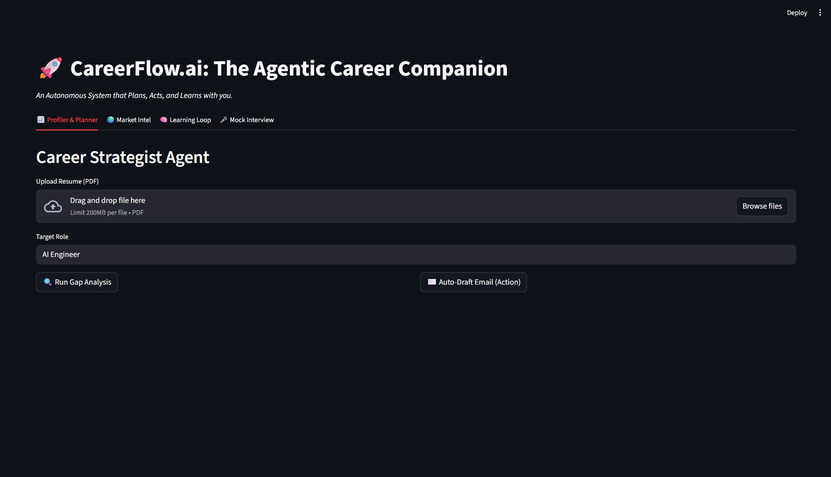

Slide 10
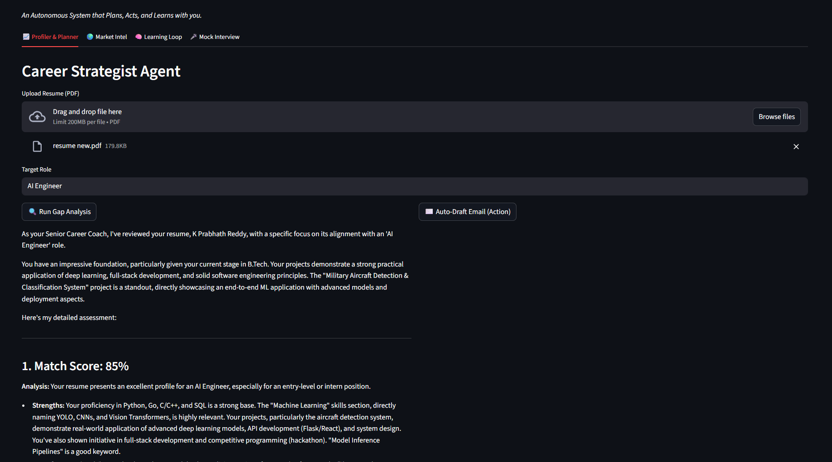

Slide 11
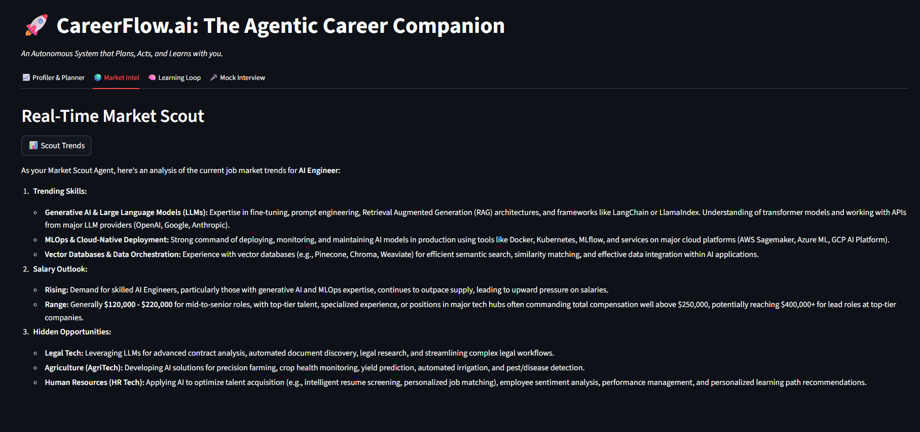

Slide 12
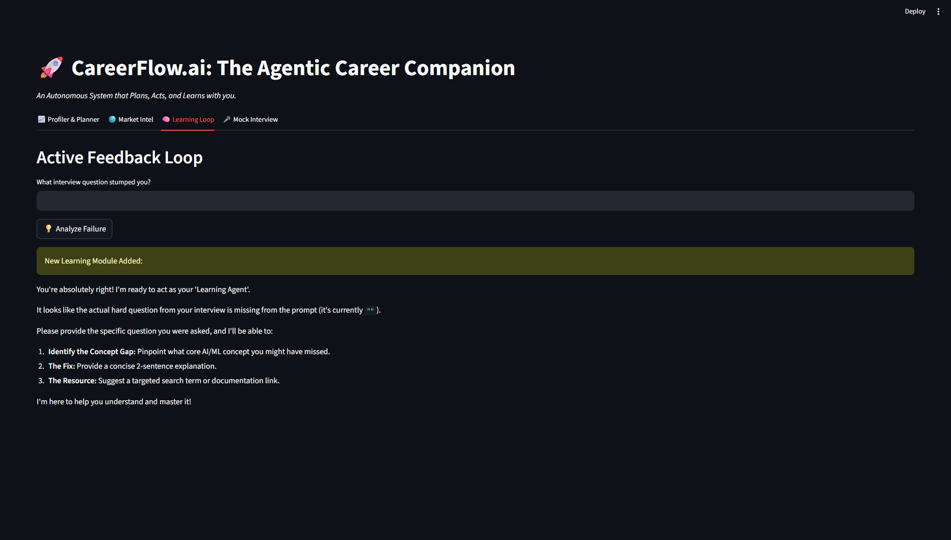

Slide 13
Future Roadmap Content
Current MVP
Networking
Vision
Resume Parsing, Learning Sprints, Email Drafting, Basic Mock Interview.
The Agent scans LinkedIn to find college alumni working at target companies and drafts "warm introduction" messages
Users upload a video intro. The AI analyzes eye contact, voice modulation, and confidence to provide behavioral coaching

Slide 14
Thank You!
Team Name : Tech Star’s
Track : Agentic-AI

